Slide 1
School Name: School of CS and IT
Course / Semester(s): 1
Team Name: Tech Titans
Team Members :
Sl. No | Name | Contribution to prototype
1 | Rui Dsouza
2 | Declan Dmello
3 | Judah Fernandes
4 | Hemant Mhalsekar
5 | Rishin Aiyappa AG

Slide 2
Target Users: Unemployed Youth
Problem Statement : Tackling NEET: Bridging Gaps in Education, Employment, and Training

Slide 3
Solution: Our platform empowers NEET individuals by bridging skill gaps, offering career guidance, and fostering entrepreneurship through tailored learning paths, mental health support, and innovative tools.
Novelty/ Innovation: This project uniquely combines technology, human-centric design, and behavioral science to address both technical and psychological barriers to entrepreneurship, empowering a sustainable community of future entrepreneurs.

Slide 4
Socio – Economic Impact
Entrepreneurial Empowerment: Equips individuals with skills and resources, fostering self-reliance and reducing unemployment.
Economic Growth: Promotes innovation and job creation, contributing to local and national economic development.
Social Inclusion: Bridges gaps for underserved communities, reducing inequality and improving access to opportunities.
Market Potential
Expanding NEET Demographic: Targets a growing global audience of individuals seeking education, employment, or entrepreneurial opportunities.
Rising Demand for Skill Platforms: Aligns with the increasing need for personalized learning and mental well-being tools.
Scalable and Inclusive: Adaptable for diverse markets, including urban and rural areas, ensuring broad accessibility and impact.

Slide 5
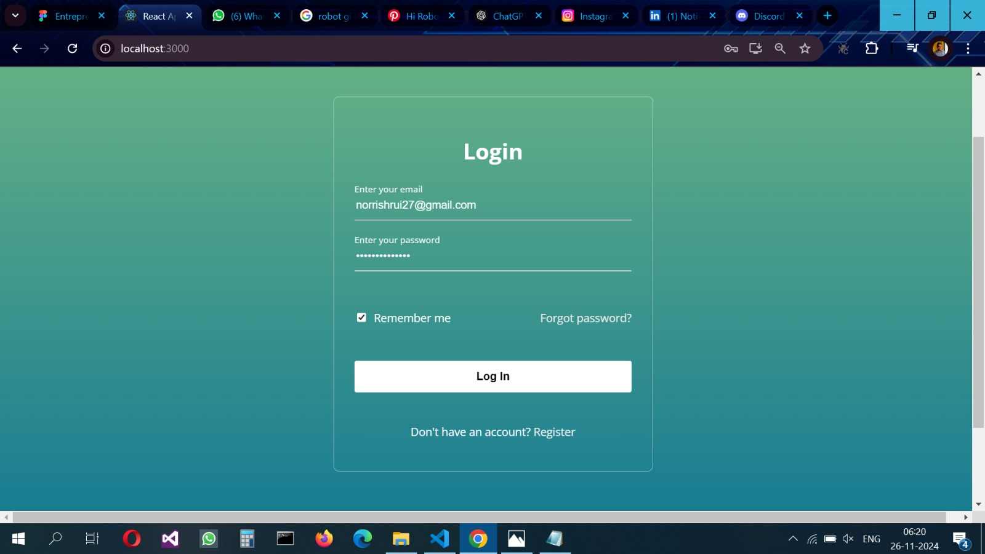
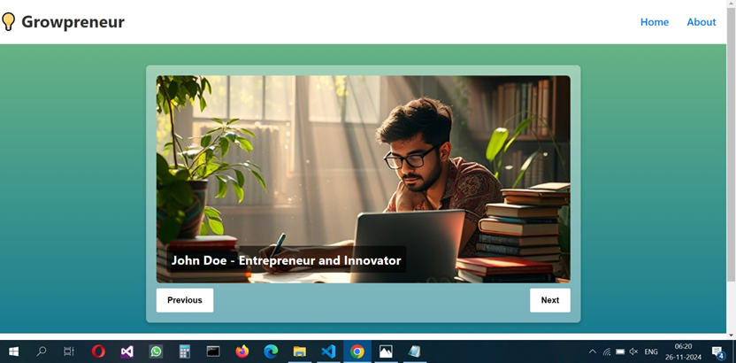
Prototype picture

Slide 6
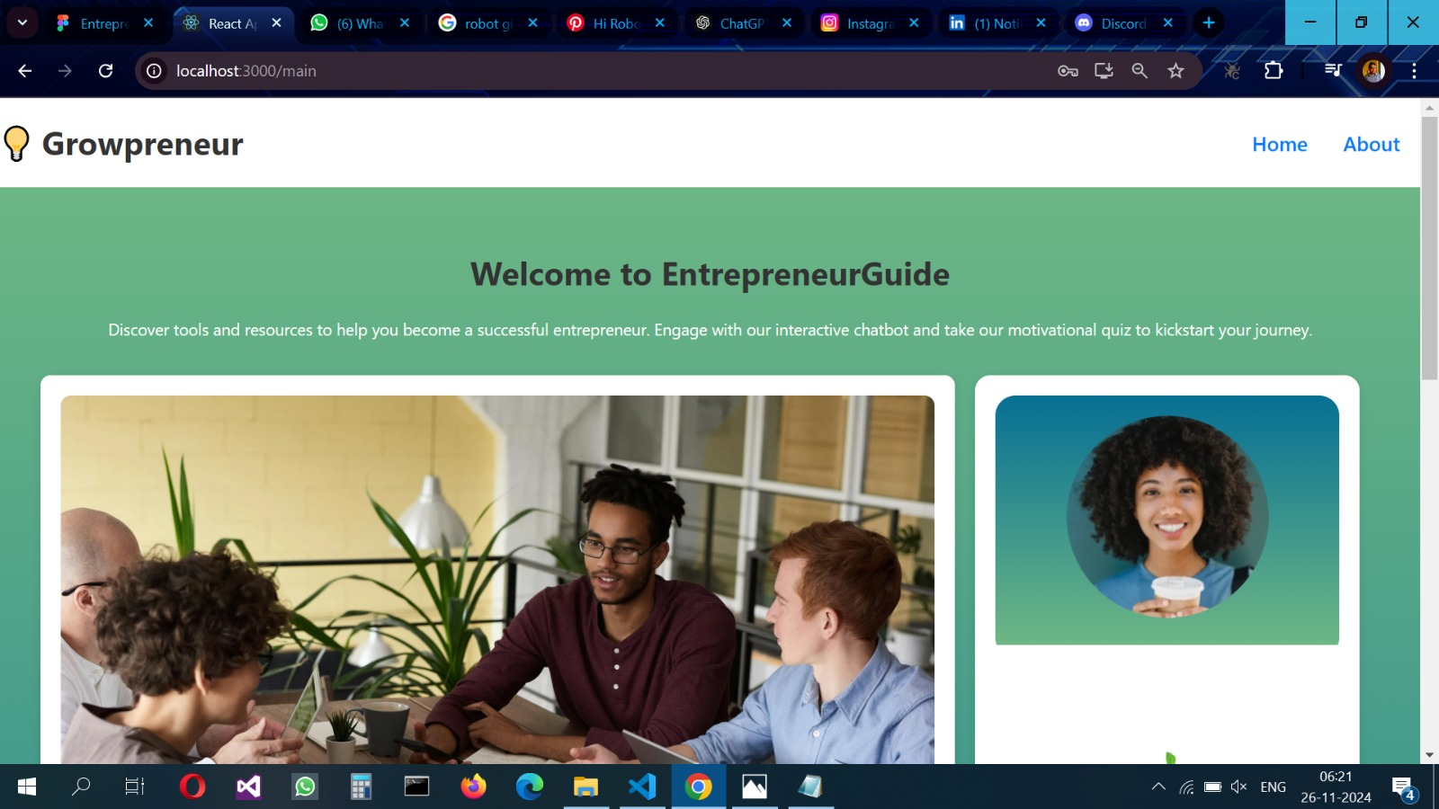
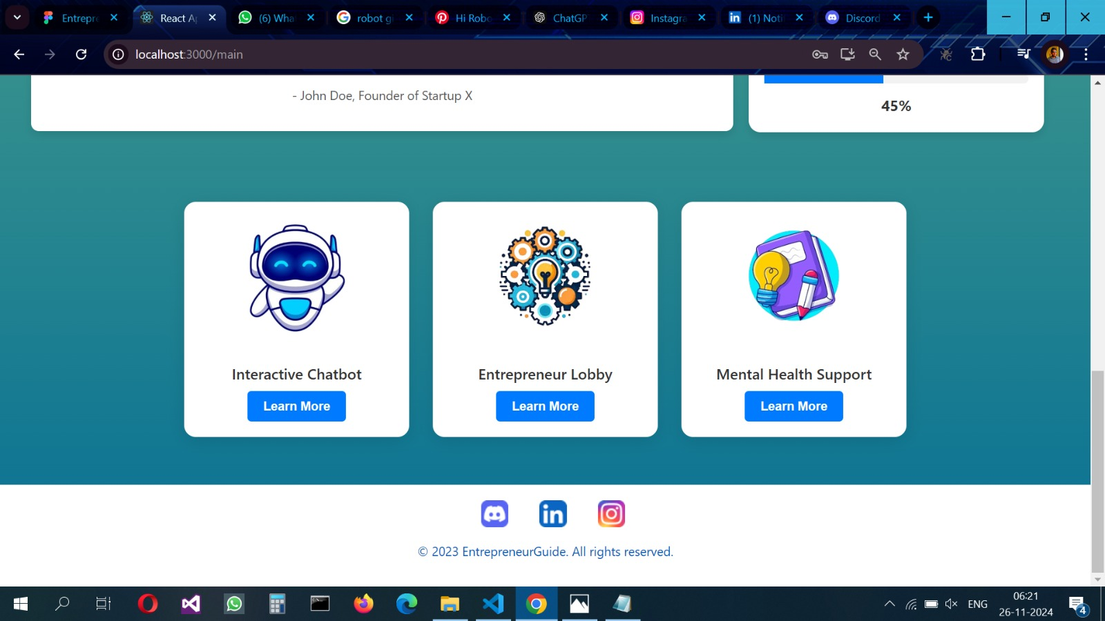

Slide 7
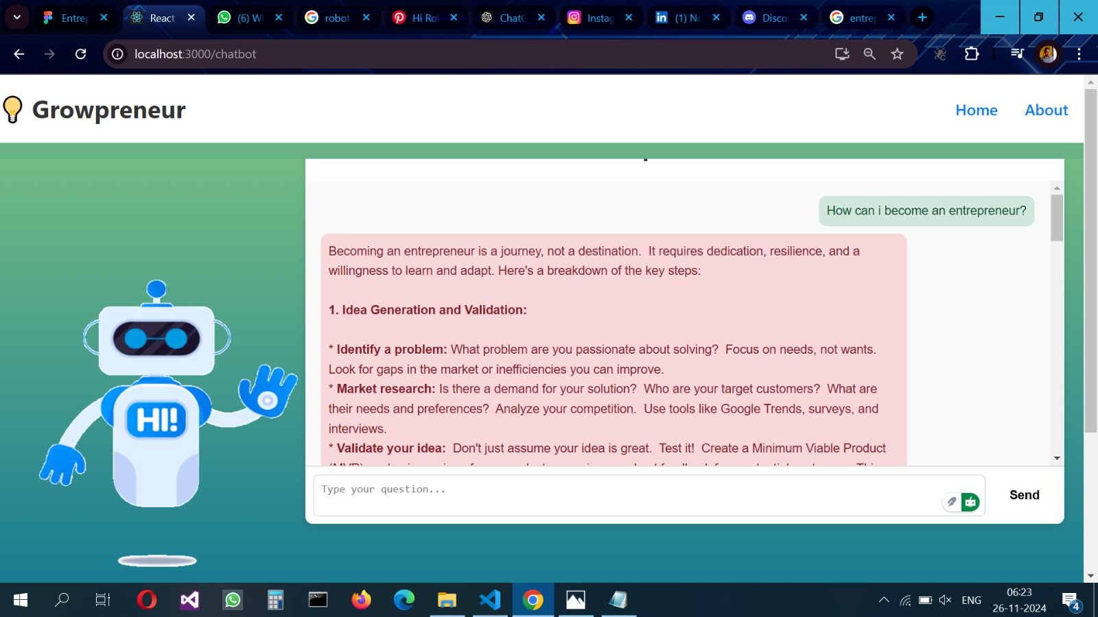
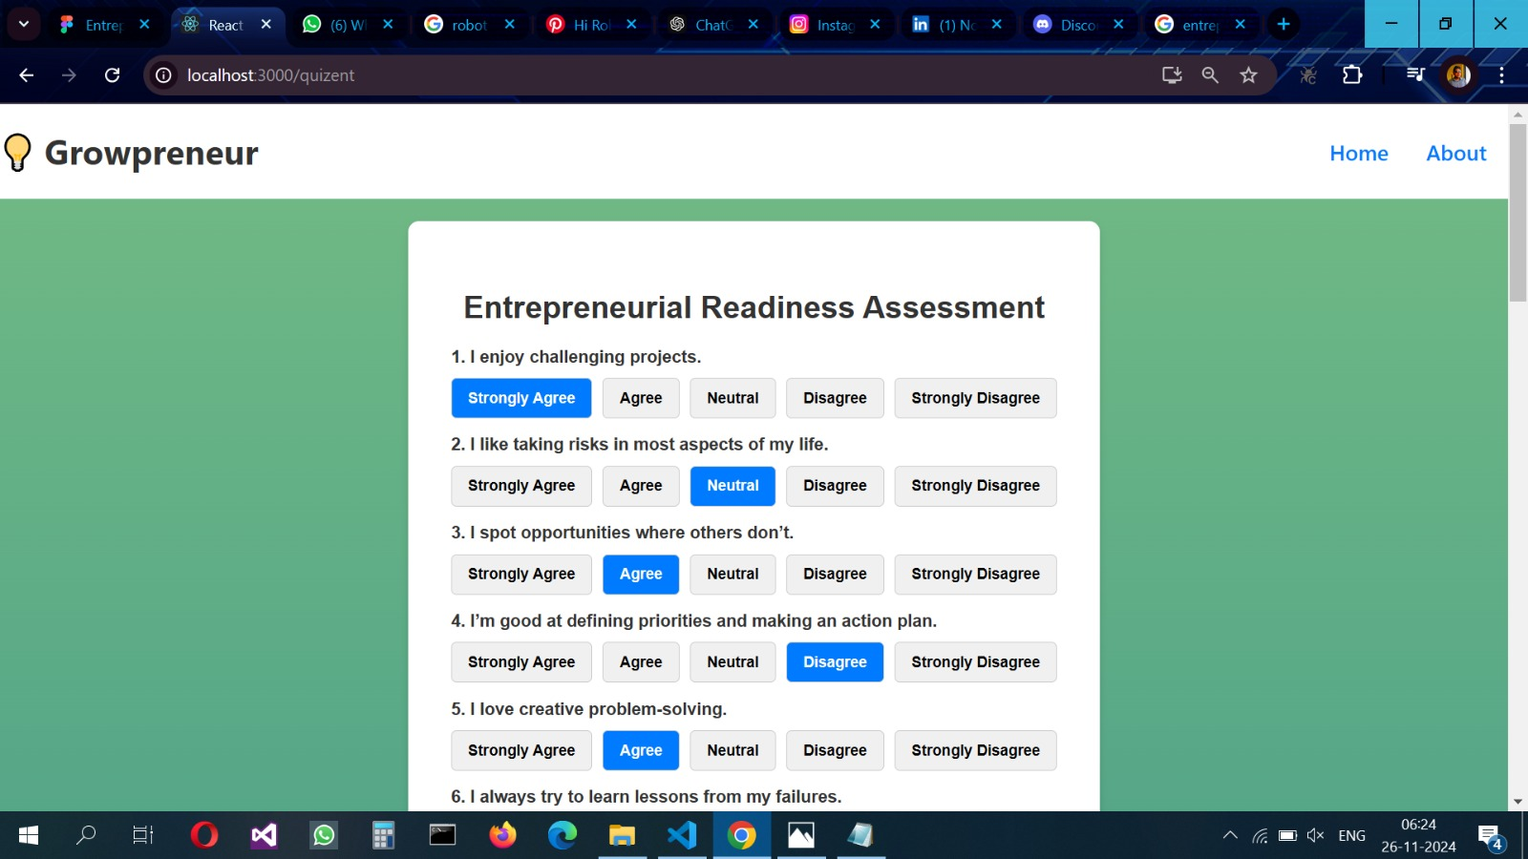

Slide 8
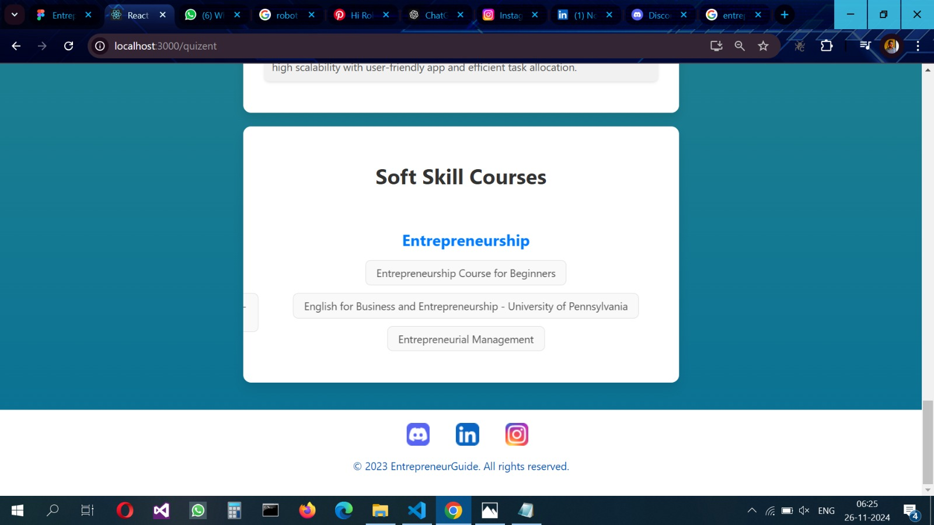
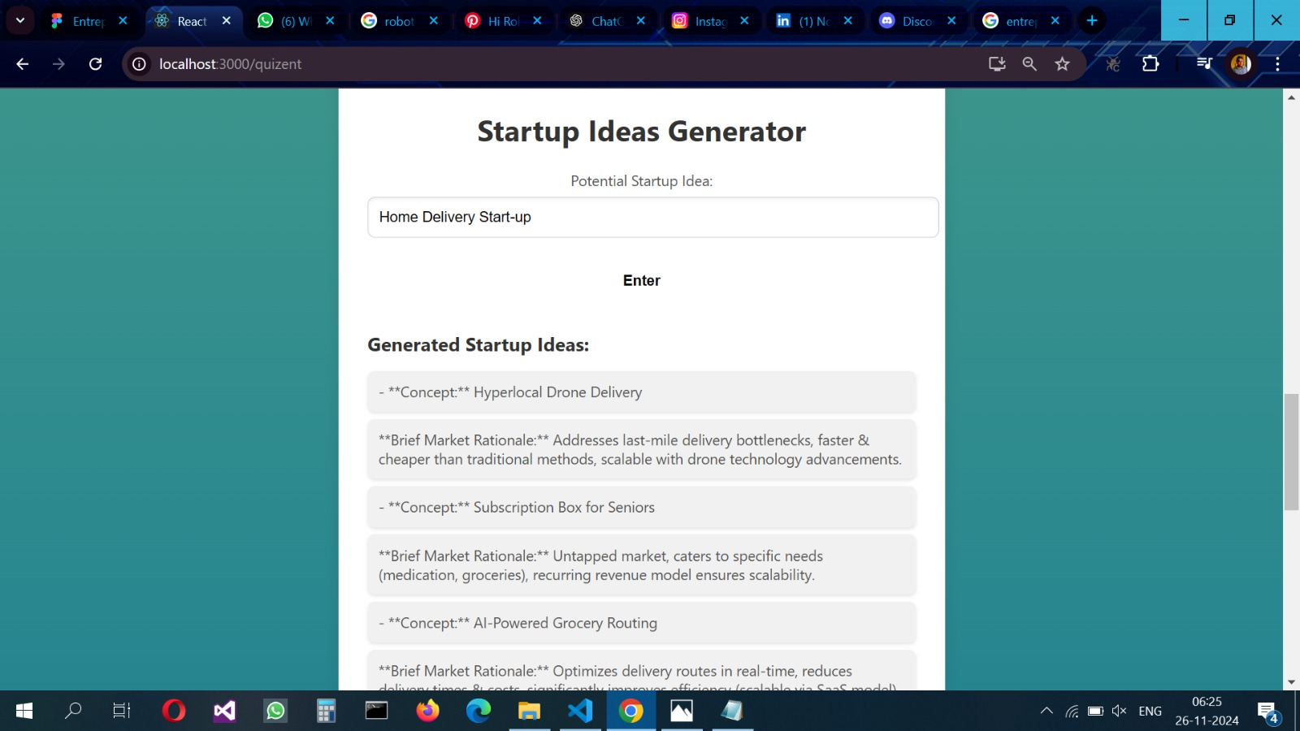

Slide 9
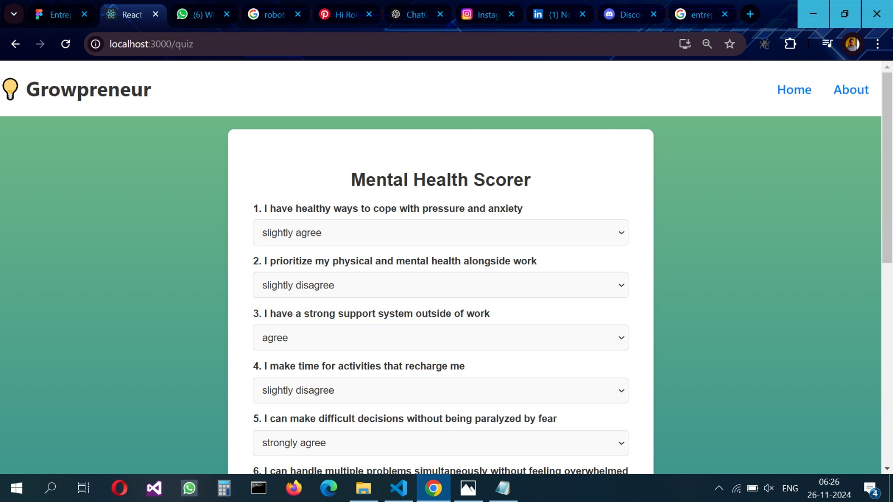
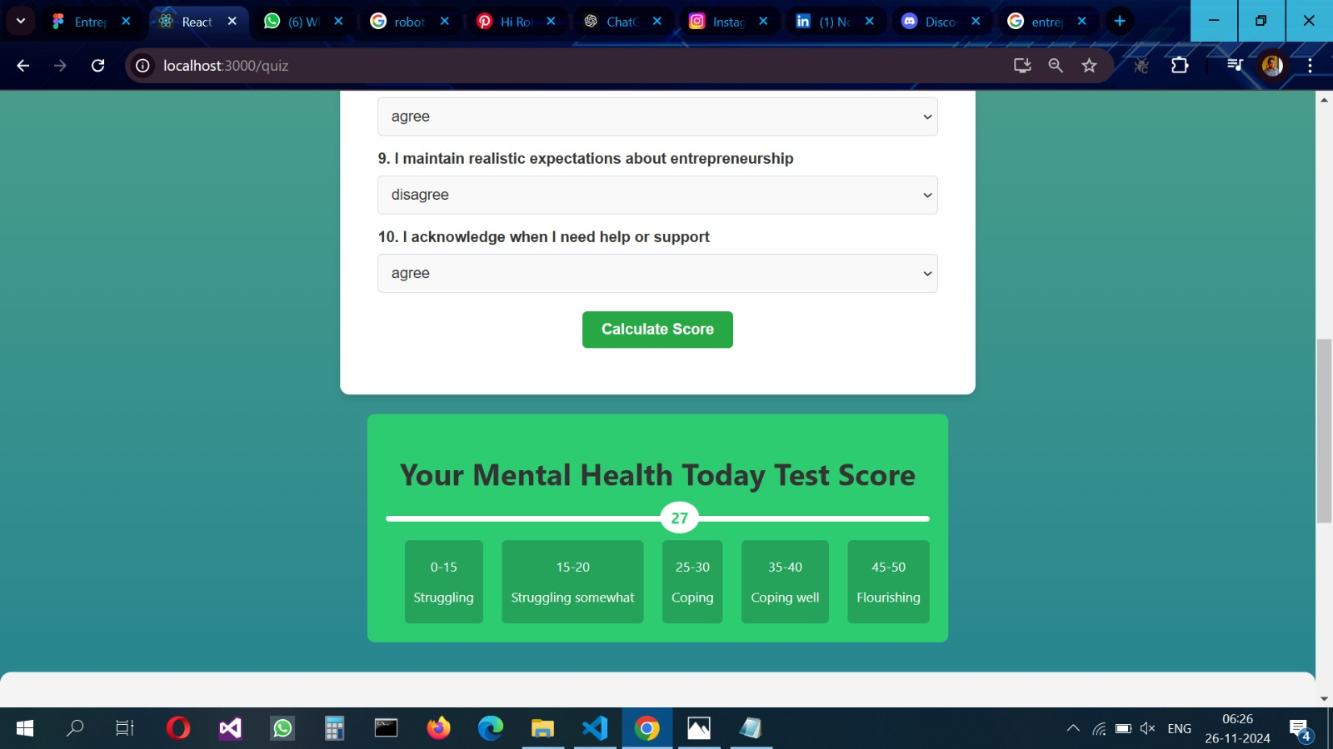

Slide 10
Team photo

